Slide 1
NTU NORTH SPINE CANTEEN A MENU SYSTEM
Group 1
FS3

Slide 2
LIVE DEMO

Slide 3
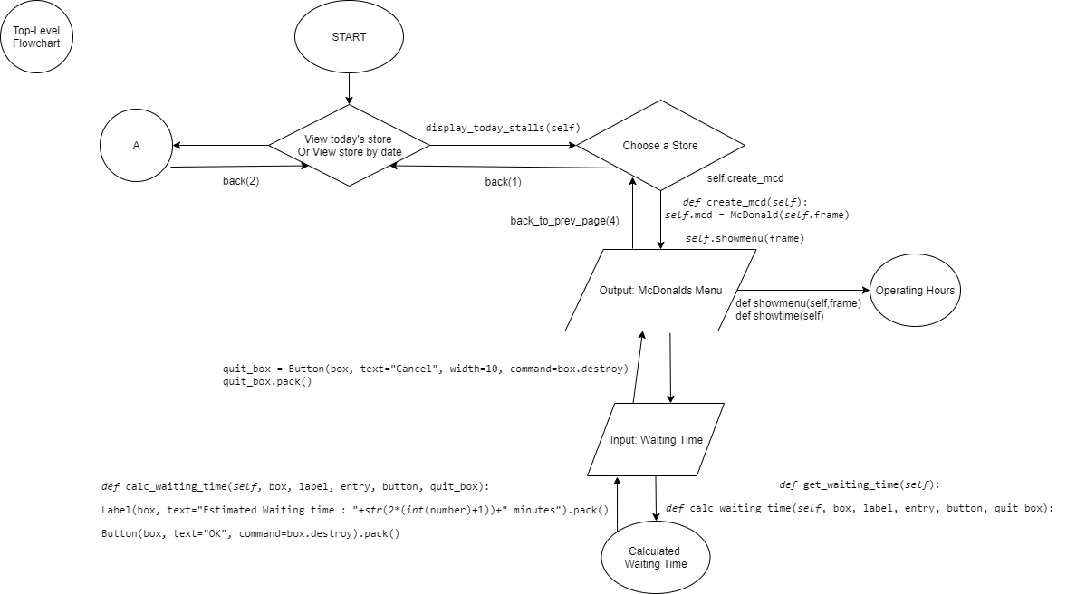
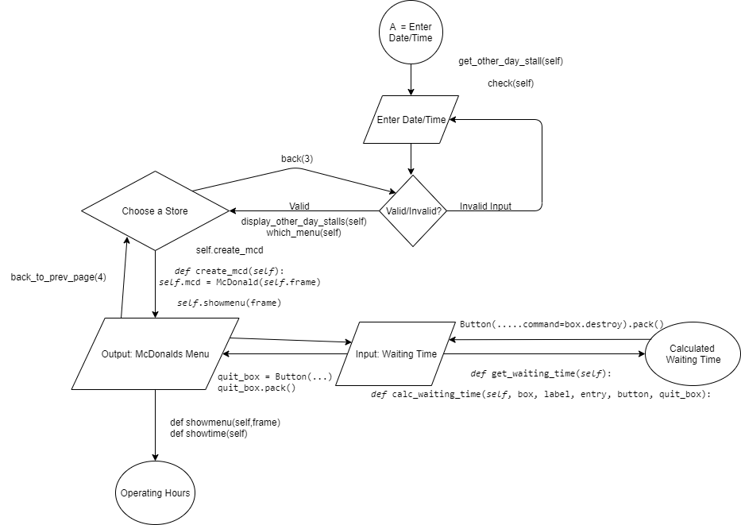

Slide 4
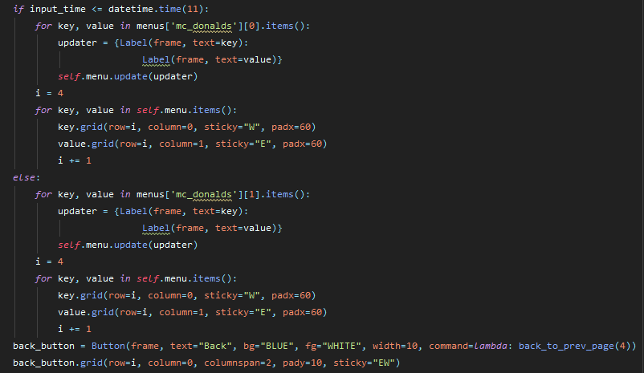

Slide 5
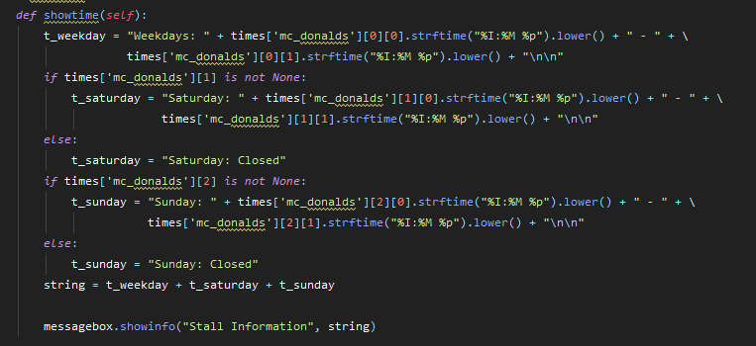

Slide 6
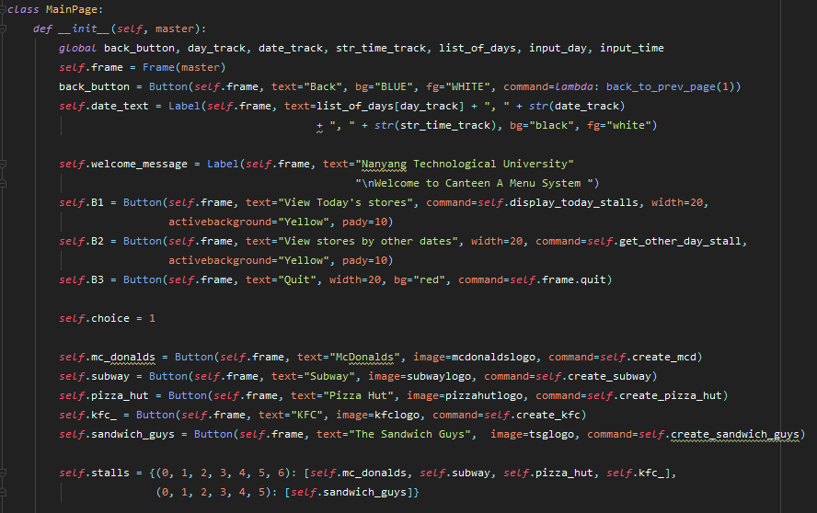

Slide 7
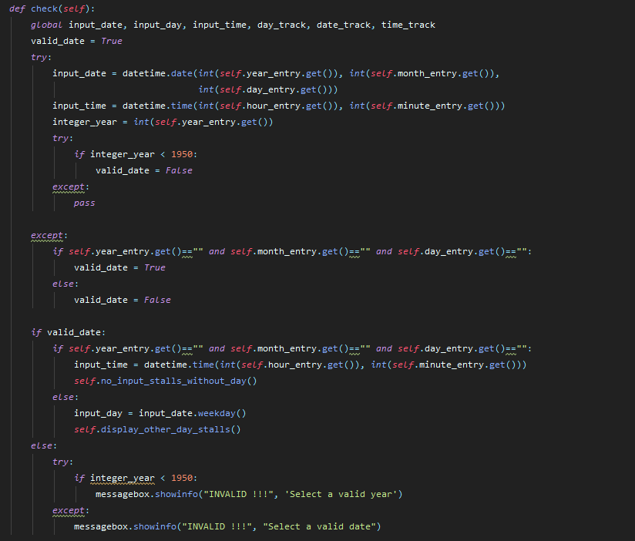

Slide 8
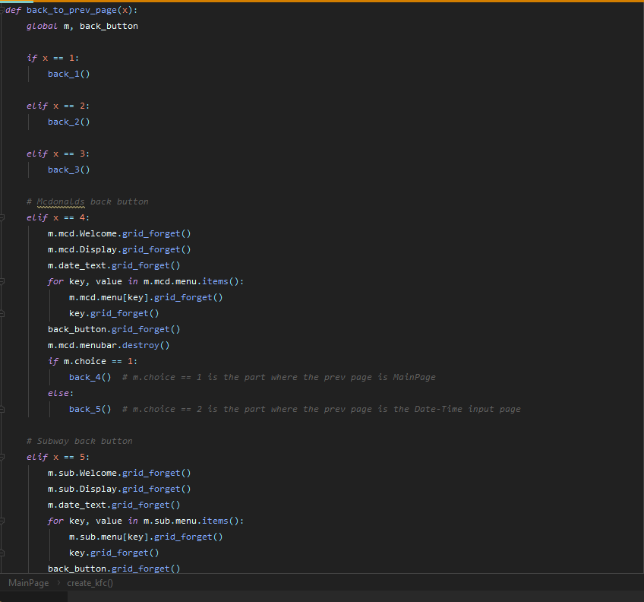

Slide 9
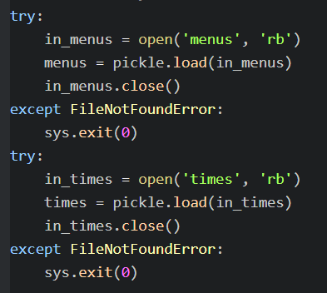
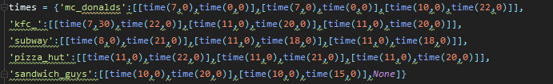
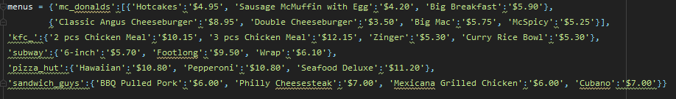

Slide 10
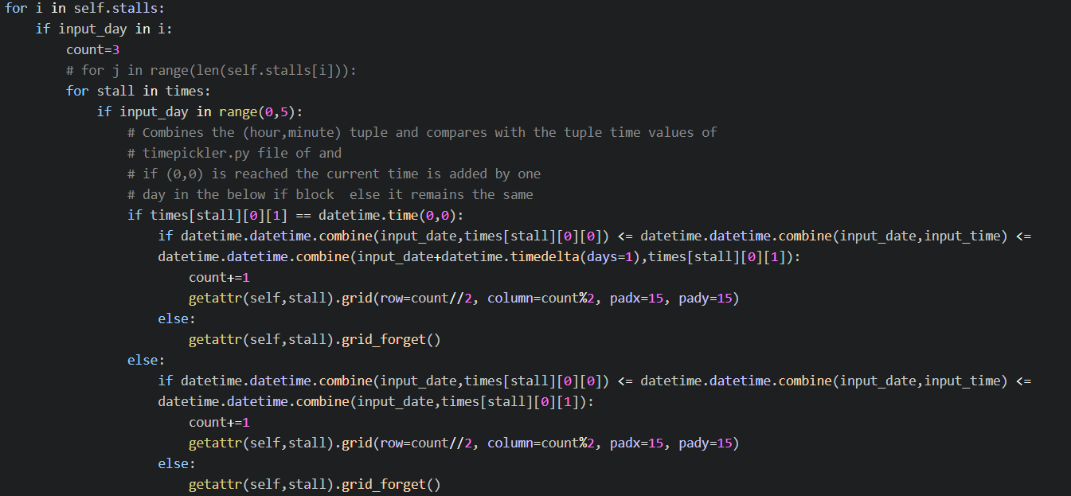

Slide 11
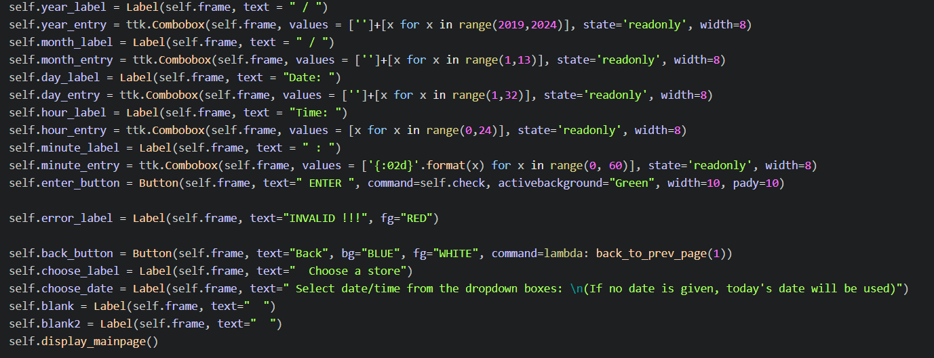

Slide 12
External Libraries
tkinter
datetime
pickle
PIL
os

Slide 13
Use of String Operations/Functions

Slide 14
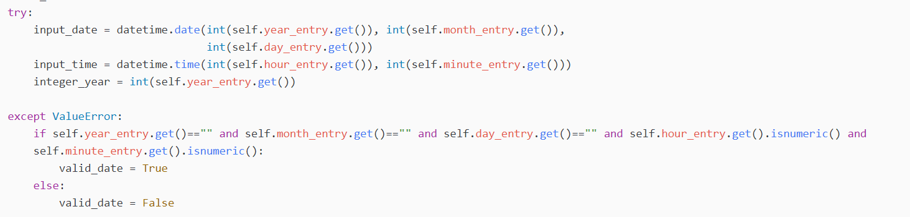
Exception handling

Slide 15
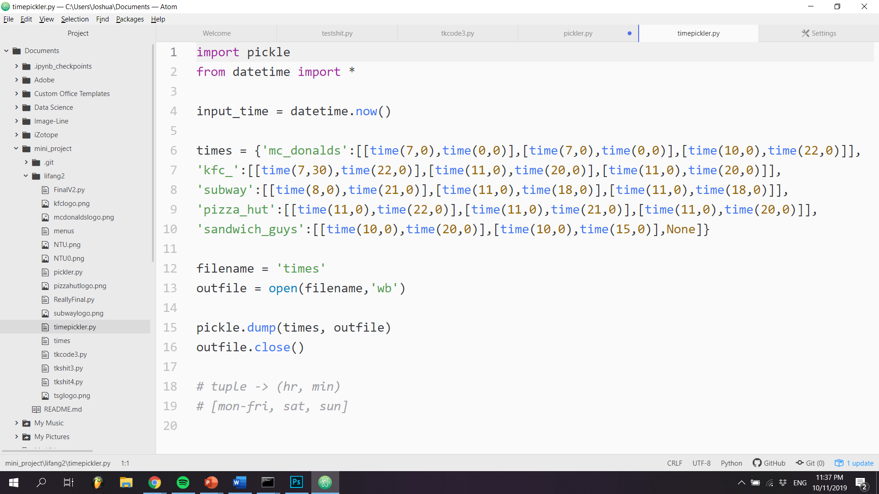
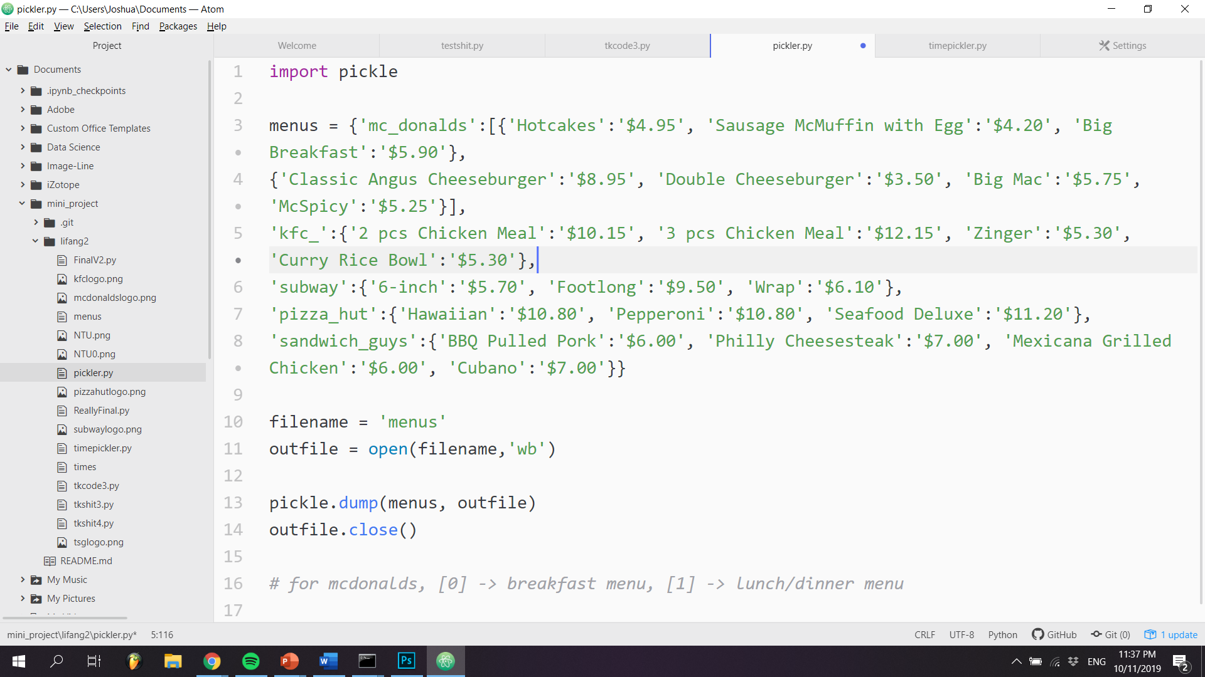
Use of tuples, lists and dictionaries

Slide 16
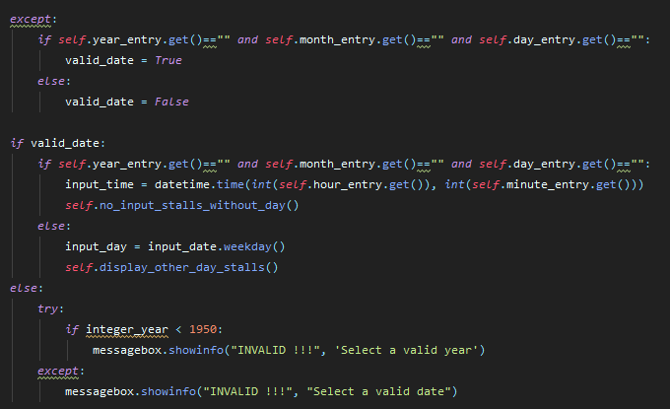
Program Correctness
The try and except block ensures input validity when the user decides to view the stalls based on a defined date and time ensuring robusity of the program.

Slide 17
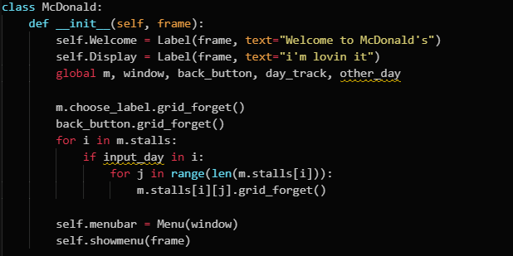
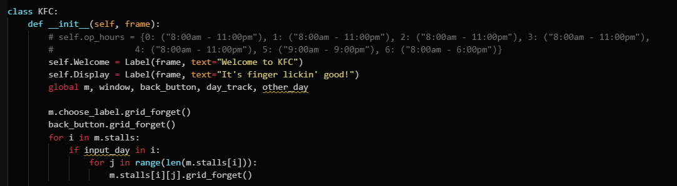
Program Organization
Each specific stall has a unique identifiable Class. For eg. McDonalds has a Mcdonalds class

Slide 18
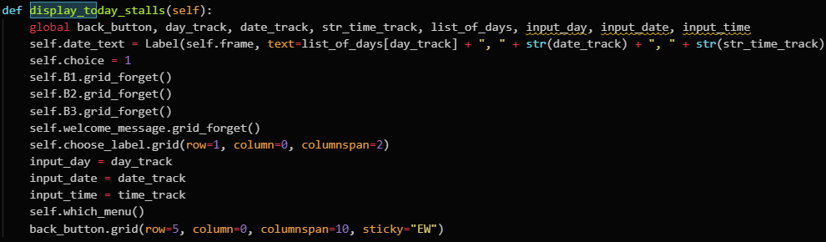
Programming style
Functions have been given appropriate for their use cases such as display_todays_stall(self) whose purpose is to display the stalls available today

Slide 19
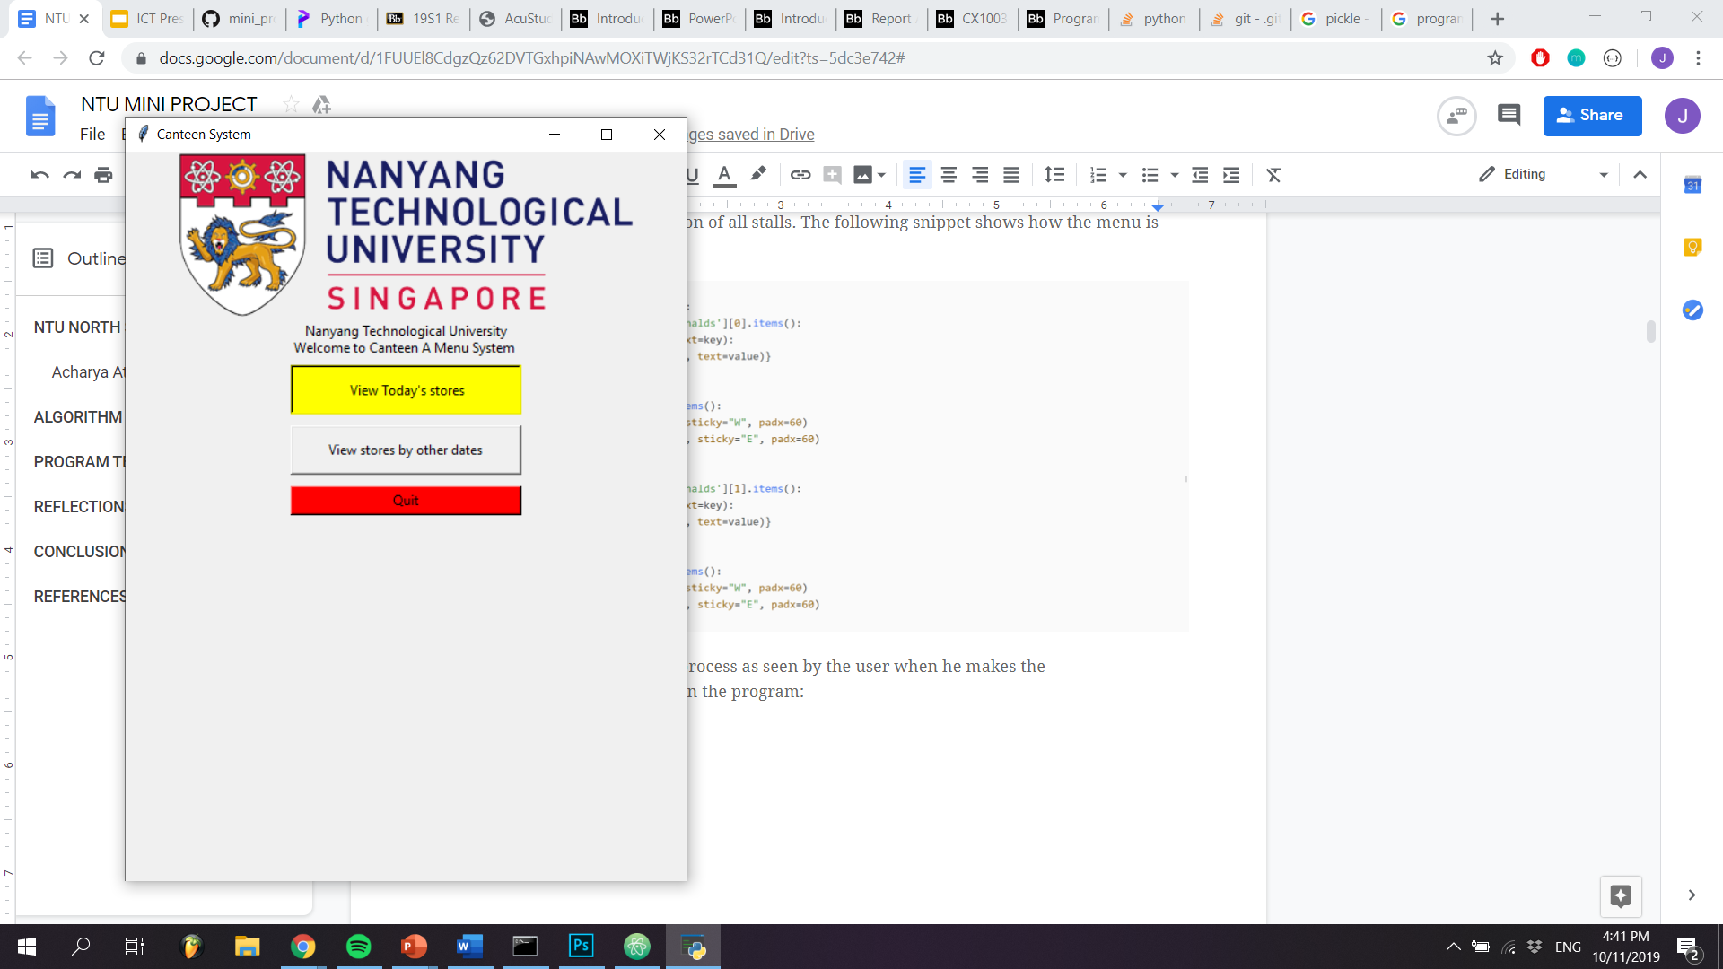
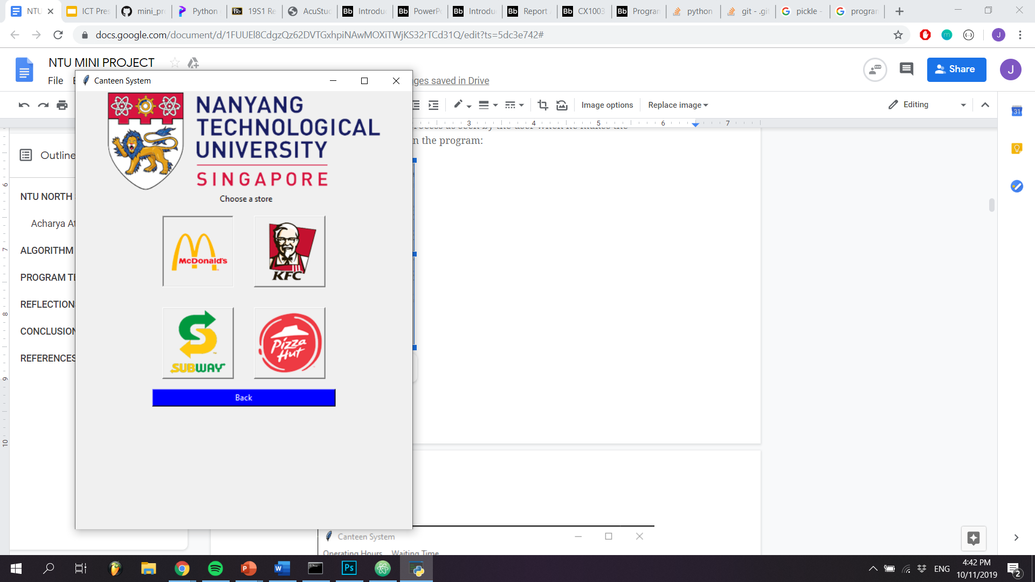
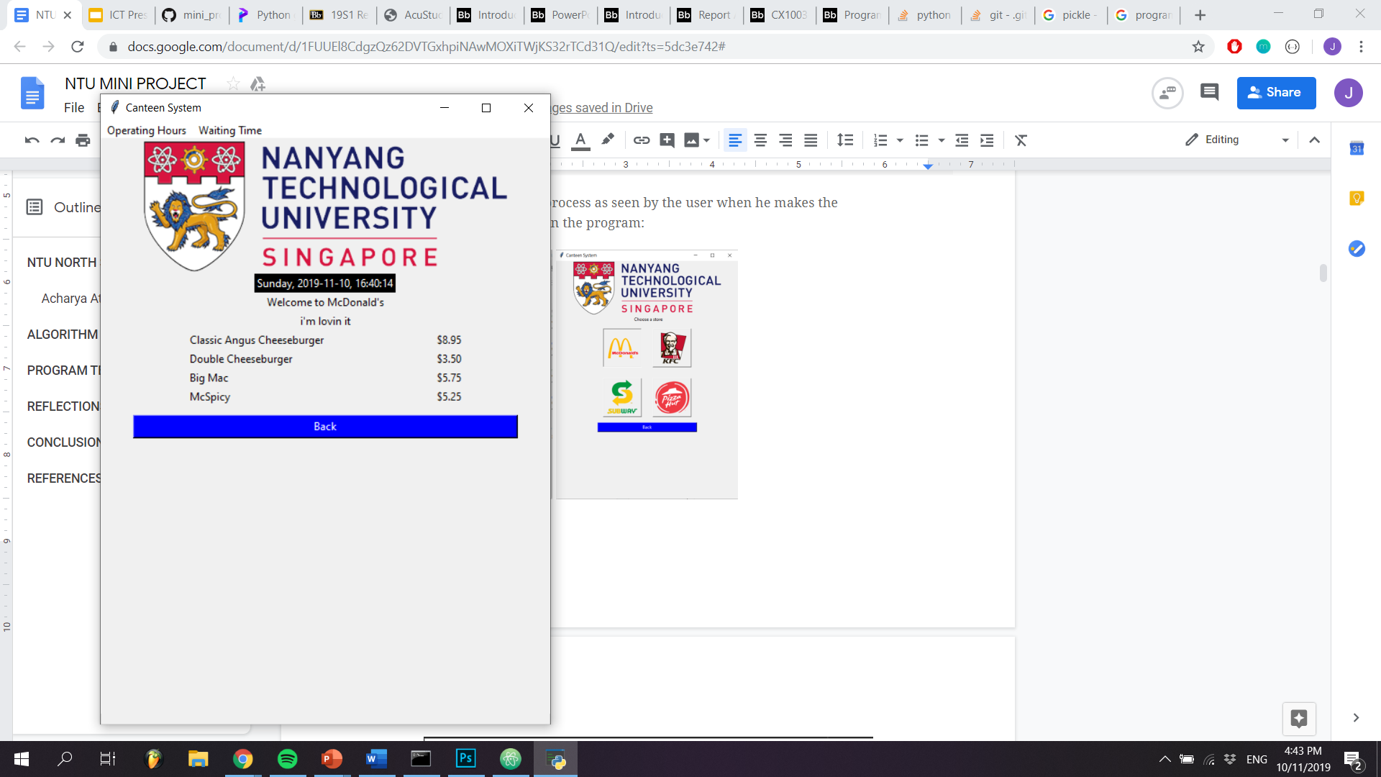
USER INTERFACE

